Slide 1

Expedia Hotel Recommendations Which hotel type will an Expedia customer book?
George Aeillo, Eric Nguyen, Arun Agarwal
Notes:
Arun

Slide 2

Data Science Problem
Hundreds of thousands of hotels exist
→ Can be hard to choose based on personal preferences/needs
Focus: predict most optimal hotel group/cluster for a user based on search and other items that occur during the user event
Current Expedia search parameters aren't customer specific
Challenge: contextualize customer data and predict likelihood a user will stay at 100 different hotel groups
Notes:
George

Slide 3

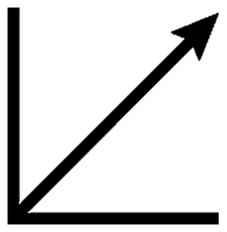
Problem Importance
Assumption: more accurate recommendations → users will spend more money
For a major company, such as Expedia, the investment in data science to develop an improved recommender system can yield massive financial gains for the company
Profits
Recommender System Performance
Notes:
George

Slide 4
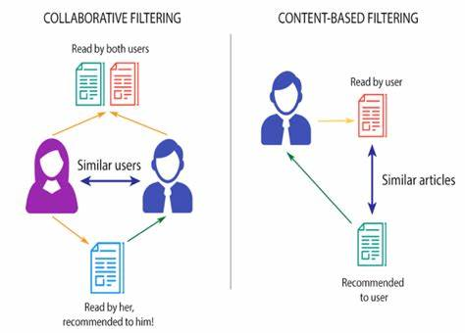
Recommender System Overview
Def: describes a system that delivers what it believes to be the optimal suggestions to a user
Two classic paradigms in recommender system design:
Collaborative Filtering - users are recommended objects that similar users have liked in the past
Content-Based Filtering - users are recommended similar objects that they have liked in the past
Hybrid Approach - combines content-based and collaborative filtering
Notes:
George

Slide 5

Training Data For Competition
Data is logs of customer behavior
24 features provided (ex: date/time, check in date, checkout date, hotel country)
Data is random selection from Expedia → not representative of overall stats
Size: 4.52 GB (90/10 train/test split)
Files:
train.csv → data from 2013 & 2014
All users in logs
test.csv → data from 2015
Some users in logs
destinations.csv → hotel search latent (pre-encoded) attributes
Features extracted from hotel reviews text
sample_submission.csv
All Expedia Data
Competition Data
Notes:
Arun

Slide 6


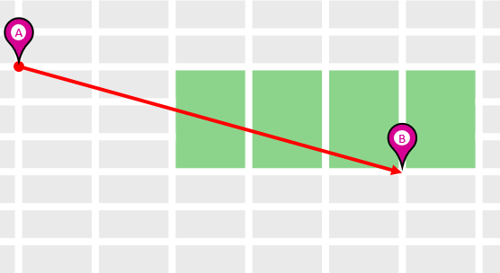

Classification Labels
100 predetermined hotel cluster/group labels (in data, numbered as 0 - 99)
Proprietary Expedia clustering algorithm to form hotel clusters
Grouped together similar hotels
Clusters serve as good identifiers to which type of hotels people will book (while avoiding outliers like new hotels)
…
Historical Price
Hotel Rating
Distance from City Center
CLUSTERING ALGORITHM
100 Clusters
Notes:
Arun

Slide 7
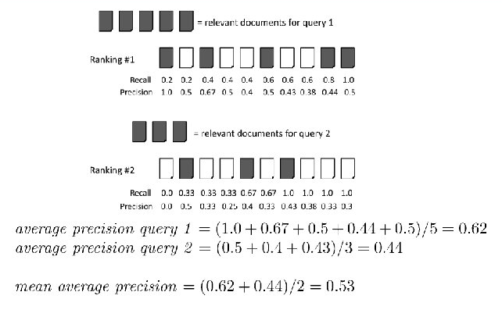
Evaluation Metric
Success in competition is measured with Mean Average Precision @ 5 (MAP@5)
Average Precision: weighted mean of precision at each threshold; the weight is the increase in recall from the previous threshold
Mean Average Precision: average of AP of each class
Notes:
Arun

Slide 8
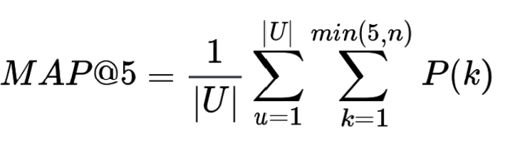
Evaluation Metric - Continued
For every user event, we predict a list of the hotel clusters they booked
Max of 5 predictions for each user/instance
Using MAP to evaluate a recommender model implies the recommendation is a ranking task
Gathering top n most confident/correct /relevant recommendations
|U| is number of user events, P(k) is the precision at cutoff value k, n is the number of predicted hotel clusters
Notes:
Arun

Slide 9
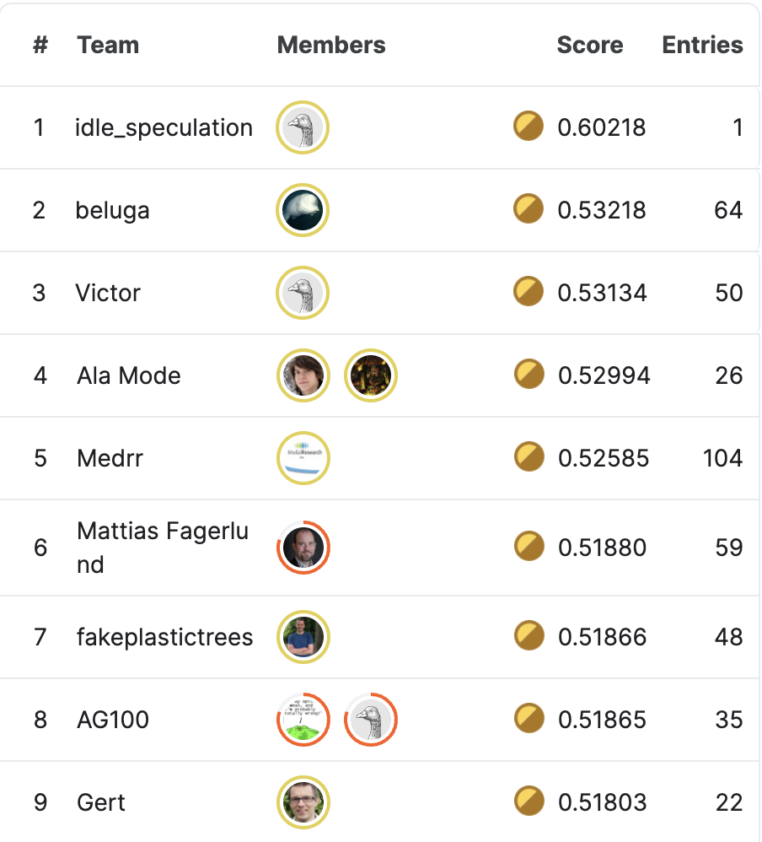

Winning Solution Overview
1,971 teams participated
22,632 entries
Duration: 56 days
Competition ran 7 years ago
$12,500
$7,500
0.602
$5,000
0.532
0.531
Notes:
Eric

Slide 10
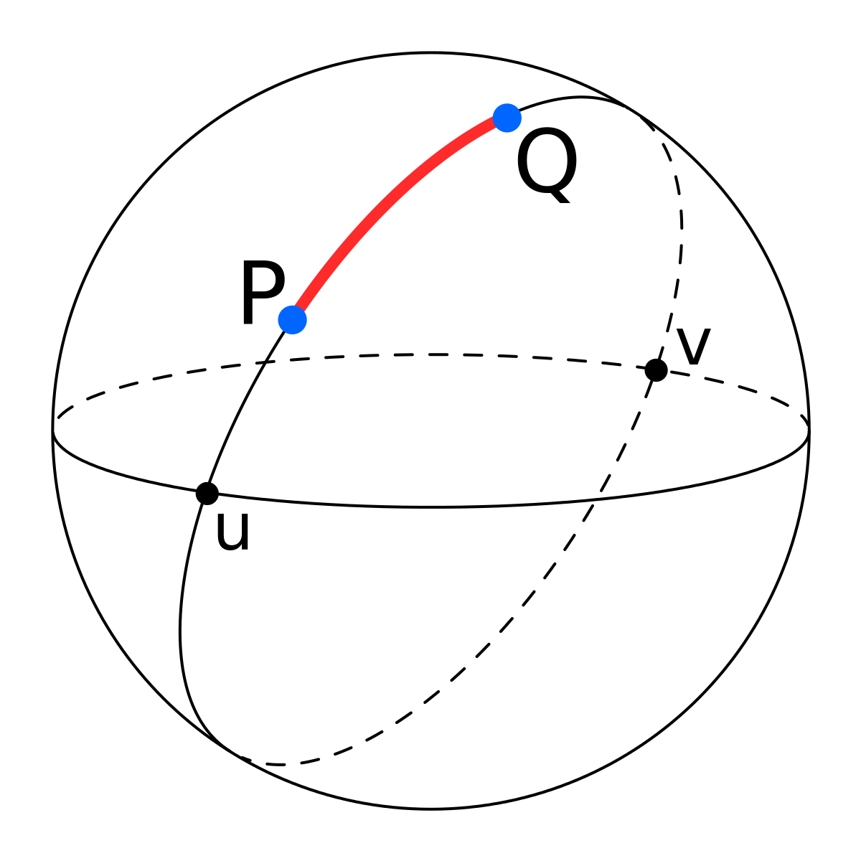
Feature Engineering and Data Augmentation Techniques For Winning Model
Fill in NA user-hotel distances by fitting spherical distance formula using the following representations:
User location (country, region, city)
Hotel location (country, market, cluster)
Create scores based on supervised learning “factorization machine” models trained on categorical features to predict hotel cluster
FMs are good for categorical variables with sparse data
Popular for recommendation systems such as click prediction and product recommendation
Each booking is repeated 100 times, for each hotel cluster
Hotel clusters are ranked for each booking
Notes:
Eric

Slide 11
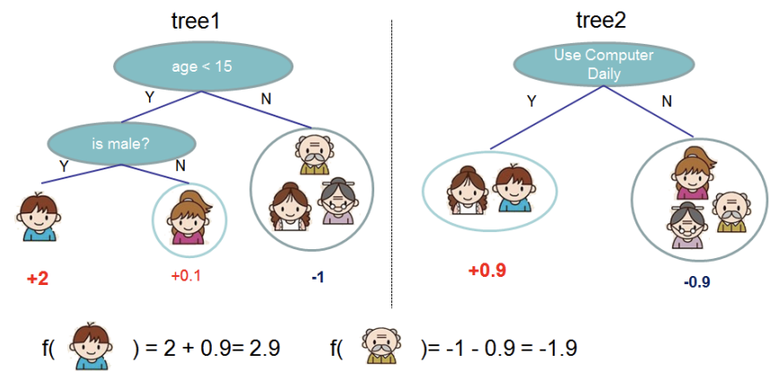
Algorithm For Winning Model
Pairwise ranking model with features:
Historical click/book rates of each cluster
Booking error between predicted and actual distance
Booking factorization machine score for each cluster
Take pairs of hotel clusters and predict the optimal order
Performs well with MAP metric
Use XGBoost, a gradient boosted tree algorithm
Ensemble of weaker prediction models (decision trees)
Notes:
Eric

Slide 12
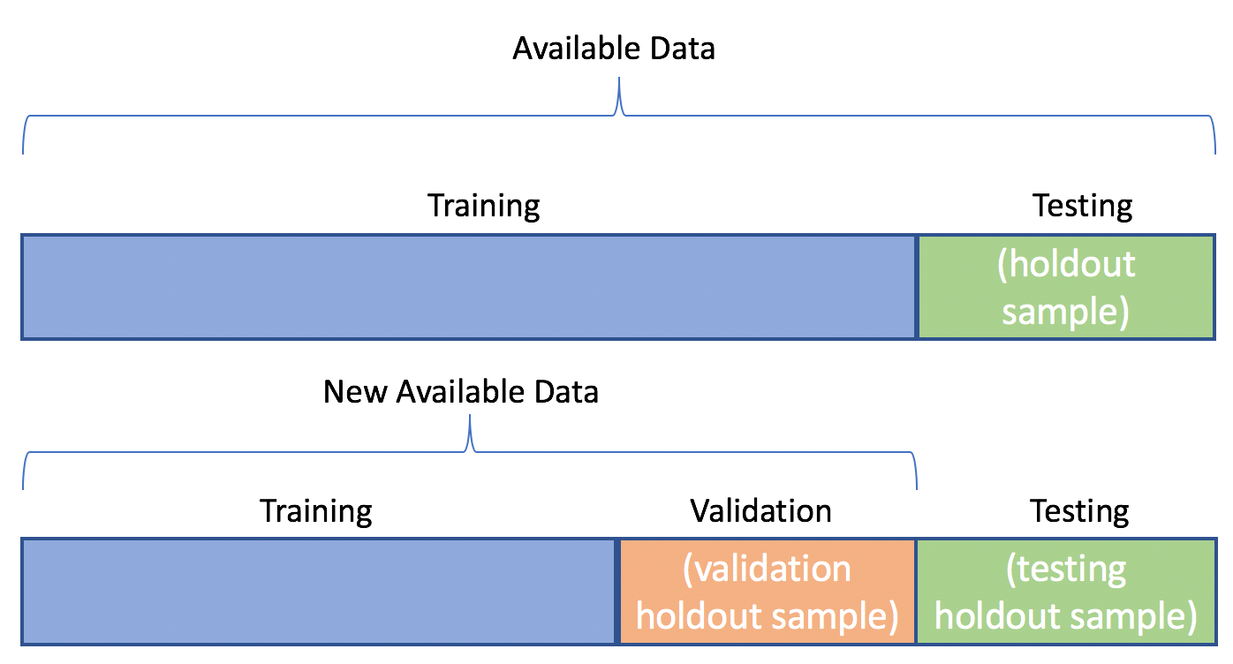
Training For Winning Model
Model evaluated on data from 7/1/2014 - 12/31/2014
Model trained on data before 7/1/2014, mirroring 2015 test data situation
Some data reserved for validation from 7/1/2014 onwards
Notes:
Eric

Slide 13
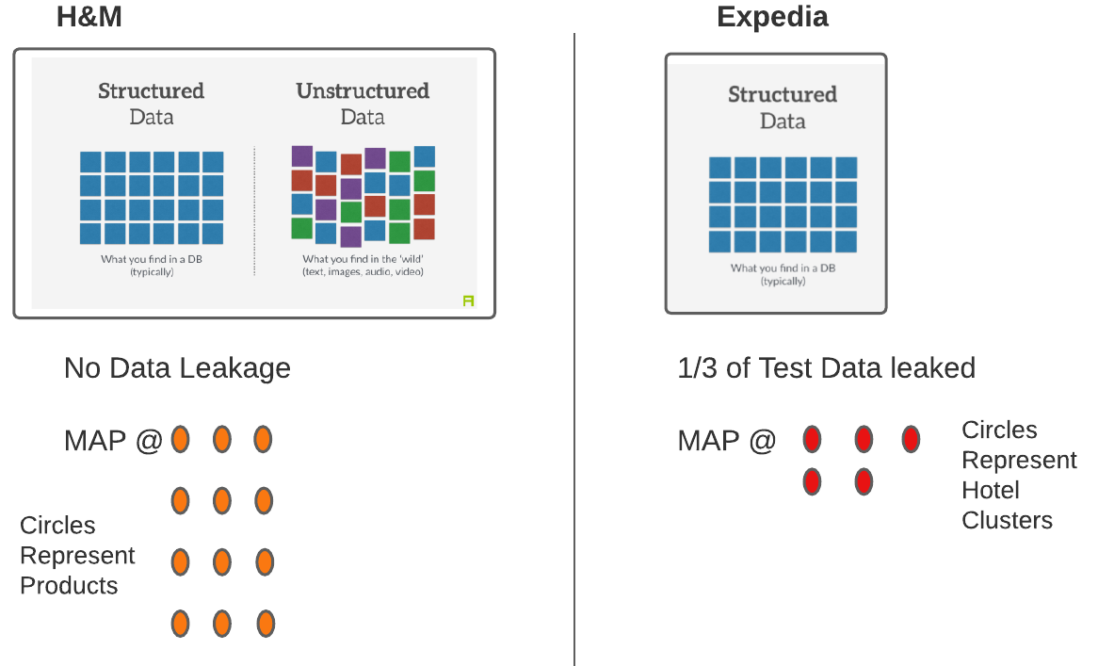
Differences From Their Project
Notes:
George

Slide 14

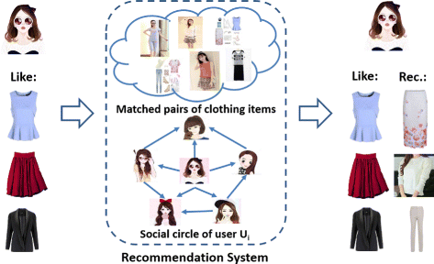
Applications To Their Project
Similar evaluation metrics
Can use traditional recommender system approaches/ apply winning approaches from this project as starting point
Layer unstructured data on top of these existing benchmarks
Notes:
George

Slide 15
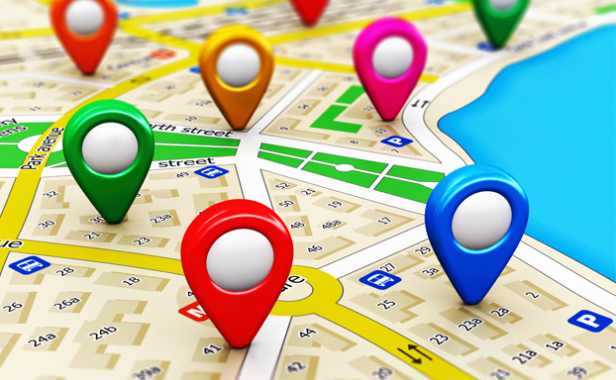
Topics/Technologies of Further Interest
Location-Based Data
Clustering
Recommender System Design
Recommender System Implementation
User-generated data
Improving The User Experience
Notes:
George

Slide 16
References
Expedia Hotel Recommendations | Kaggle
H&M Personalized Fashion Recommendations | Kaggle
MAP with Recommender Systems
MAP Explained
What Content-Based Filtering is & Why You Should Use it | Upwork
Expedia Preparing to Enter the Mobile Booking Game – Phandroid
12 Money Apps That Will Help You Save and Eliminate Debt in 2017 | by Product Hunt | Product Hunt
Expedia Business
Content-based filtering and Collaborative filtering recommendation. | Download Scientific Diagram (researchgate.net)
Great-circle distance
1st place solution
XGBoost
MAP Explained
Factorization Machines Algorithm
Different Hotels
Using Deep Learning for Structured Data with Entity Embeddings | by Rutger Ruizendaal | Towards Data Science
Location-based data is a new tool for managers (geospatialworld.net)
H&M - Wikipedia
Distance
Hotel Rating
Price
Consumer Behavior
Clusters
Dataset
The illustration of our task: make a recommendation of clothing based... | Download Scientific Diagram (researchgate.net)
Train/Test Split and Cross Validation - A Python Tutorial - AlgoTrading101 Blog
Predicting User Preferences with XGBoost Learning to Rank Method
Notes:
Arun

